Slide 1

NPRI DATA
GROUP MEMBERS
KHUSHI
ANUREET
KAWAL

Slide 2

Problem Statement
Using the historical data in the dataset, the machine learning task is to forecast the percentage of releases to disposals in the next five years.

Slide 3
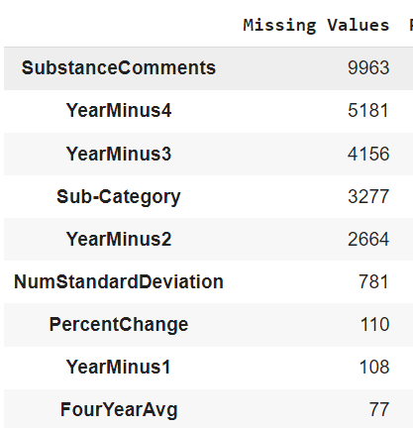
What Problem we faced…..
Inconsistency
Missing Values (537,479 records)
Data Types
Potential Duplication or Redundancy

Slide 4
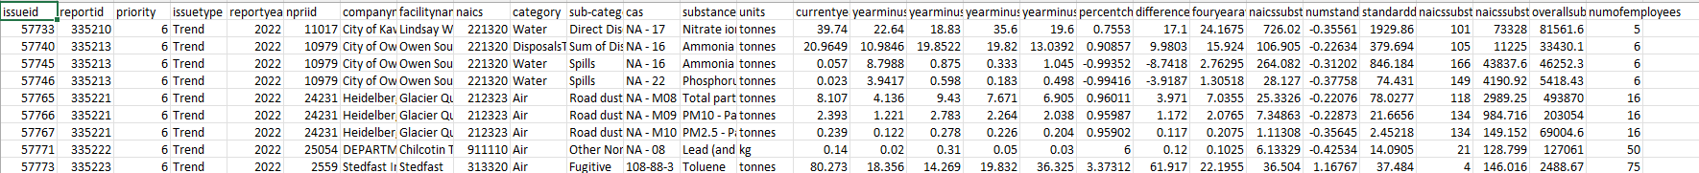
Introducing of new dataset
We merged unclean and the review dataset because we find features same.
Uncleaned data (CLEAN)
NPRI(review) DATASET

Slide 5

Problems while Merging
Feature Names (Rename)
Merged using Outer method (Returns all rows from both df1 and df2, with NaN in places where there is no match.)
Unwanted Rows and column (Drop)
Time Series Dataset
Duplicates

Slide 6
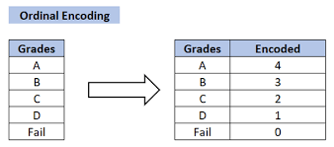
Categorical data encoding methods
ONE-HOT ENCODING
One-hot encoding transforms a categorical variable into a series of binary columns, with each column representing a possible category value
TARGET ENCODING
Target encoding replaces a categorical variable with the average value of the target variable for each category.

Slide 7
Reasons Why we use…
issuetype: Contains categorical data ('Trend'). Each unique category would be assigned a unique integer.
companyname: Text data representing company names. Each company would be assigned a unique integer.
facilityname: Text data for facility names. Each facility would be assigned a unique integer.
category and sub-category: These categorical fields would each be converted to a set of integers representing the different categories and subcategories.
cas: The Chemical Abstracts Service (CAS) number, which is a unique identifier for chemical substances. Even though it's numerical, it's categorical because the numbers are identifiers and don't have a mathematical meaning. Each unique CAS number would be assigned a unique integer.
units: This is likely categorical, representing the units of measurement (like 'tonnes'). Each unit type would be assigned a unique integer.
Category_type : 0 is for Disposal and 1 is for release which would make easier for the model to learn about the which substance we are talking here.

Slide 8
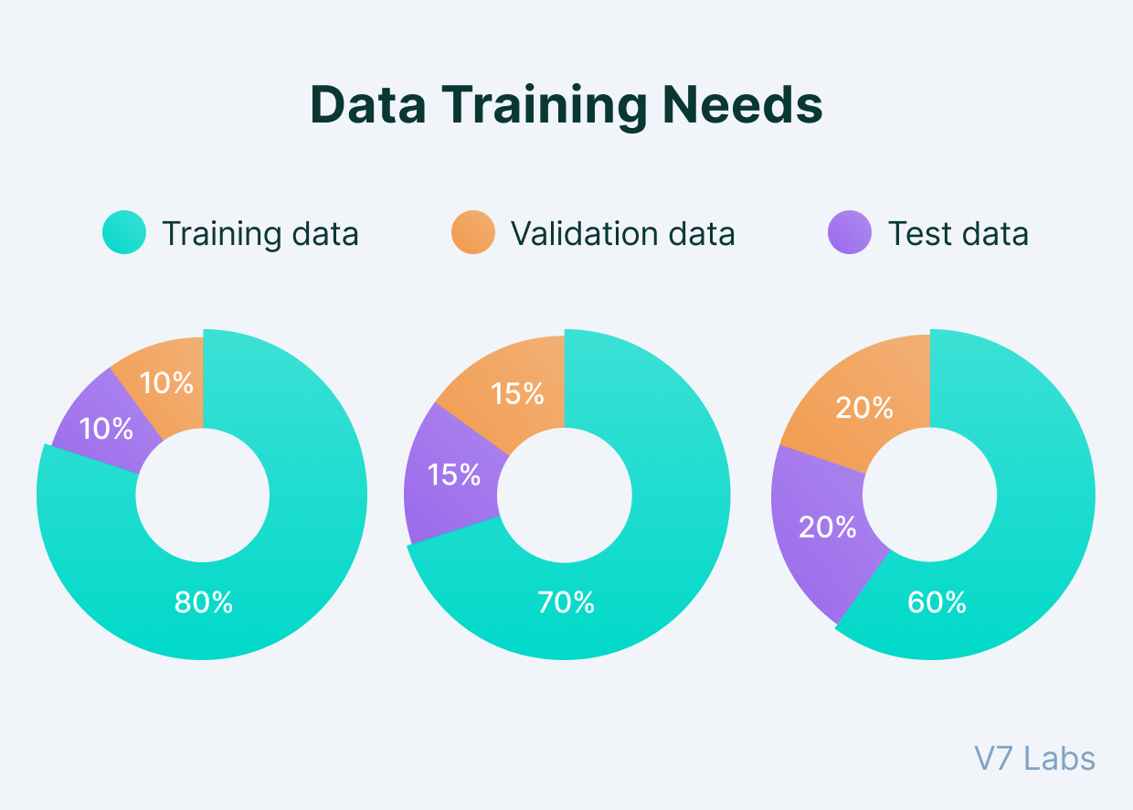
Train, Test & Validation of dataset
Data Preprocessing:
Handle missing values and categorical variables and remove unnecessary columns.
Extract relevant features impacting the percentage of releases to disposals.
Splitting the Data:
Training set: Up to 2022 (inclusive).
Testing set: From 2023 onwards.
Model Selection:
Options include Linear Regression, Random Forest and Decision tree.
Experiment with different models for best performance.
Feature Engineering:
Feature Encoding, Feature Selection And created new features (Release and Disposal)
Model Training and Evaluation:
Train model on training data and tune hyperparameters.
Evaluate model's performance using testing data and metrics like MAE, MSE, RMSE.

Slide 9


LET’S KNOW MORE ABOUT MACHINE LEARNING MODELS

Slide 10

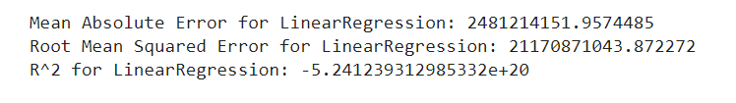

MODELS WE USED
LinearRegression
DecisionTreeRegressor
RandomForestRegressor
RESULTS WE RECEIVED AFTER USING THESE MODELS

Slide 11

OUR BEST PERFORMED MODEL & WHY?
Best Model: RandomForestRegressor.
MAE: Lowest at 0.01305, indicating high accuracy.
Much lower than LinearRegression's MAE.
Slightly better than DecisionTreeRegressor's MAE.
RMSE: Lowest at 0.06076, suggesting precise predictions.
Significantly better than LinearRegression's RMSE.
Marginally superior to DecisionTreeRegressor's RMSE.
R² Value: Closest to 1 at 0.99568, signifying excellent fit.
Far superior to LinearRegression's negative R².
Comparatively higher than DecisionTreeRegressor's R².
Overall: RandomForestRegressor outperforms others in predictive accuracy and reliability for the NPRI dataset.

Slide 12

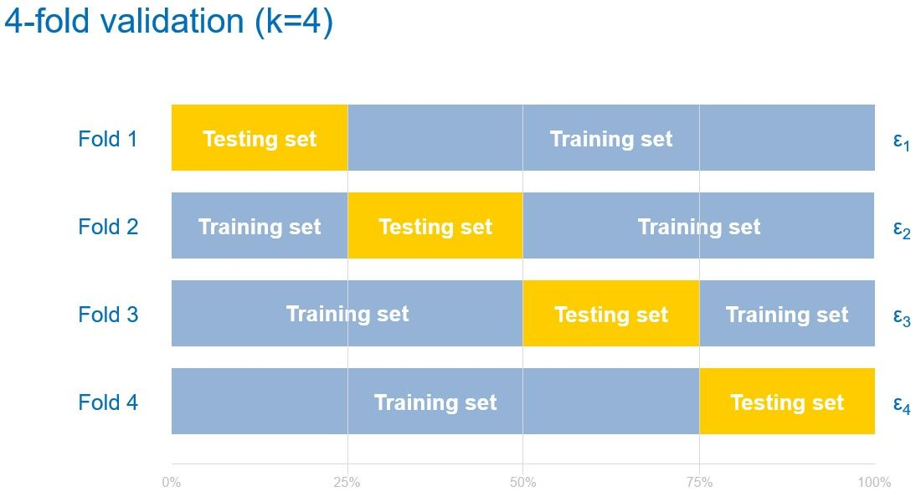
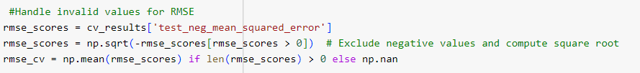
CROSS – VALIDATION OF DATASET
RESULTS FOR CROSS VALIDATION

Slide 13
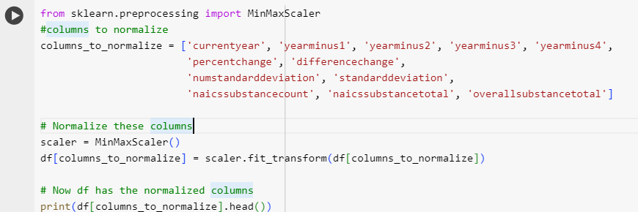
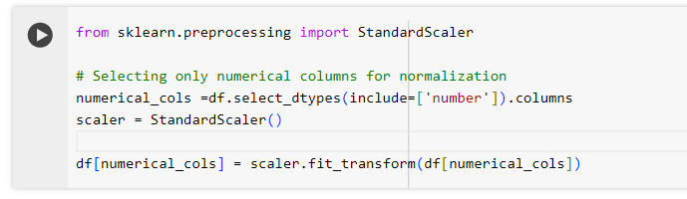
NORMALIZATION
1. MinMax Scaling
Purpose: Scales the data to a fixed range, typically 0 to 1.
Method: Transforms each value in a column by scaling it based on the column's minimum and maximum values.
2. Standard Scaling
Purpose: Normalizes data to zero mean and unit variance (standard deviation).
Method: Adjusts data distribution to form a bell curve centered at zero with values spread according to standard deviation

Slide 14
NEW FEATURES ADDED TO OUR DATASET
Category column (release\disposal)
Average four_year_total
percentage_releases_disposals
percent_currentyear
percent_yearminus1
percent_yearminus2
percent_yearminus3
percent_yearminus4

Slide 15

COLUMNS CREATED DURING PREDICTION
forecast_2023
forecast_2024
forecast_2025
forecast_2026
forecast_2027
RANDOMFORESTREGRESSOR

Slide 16
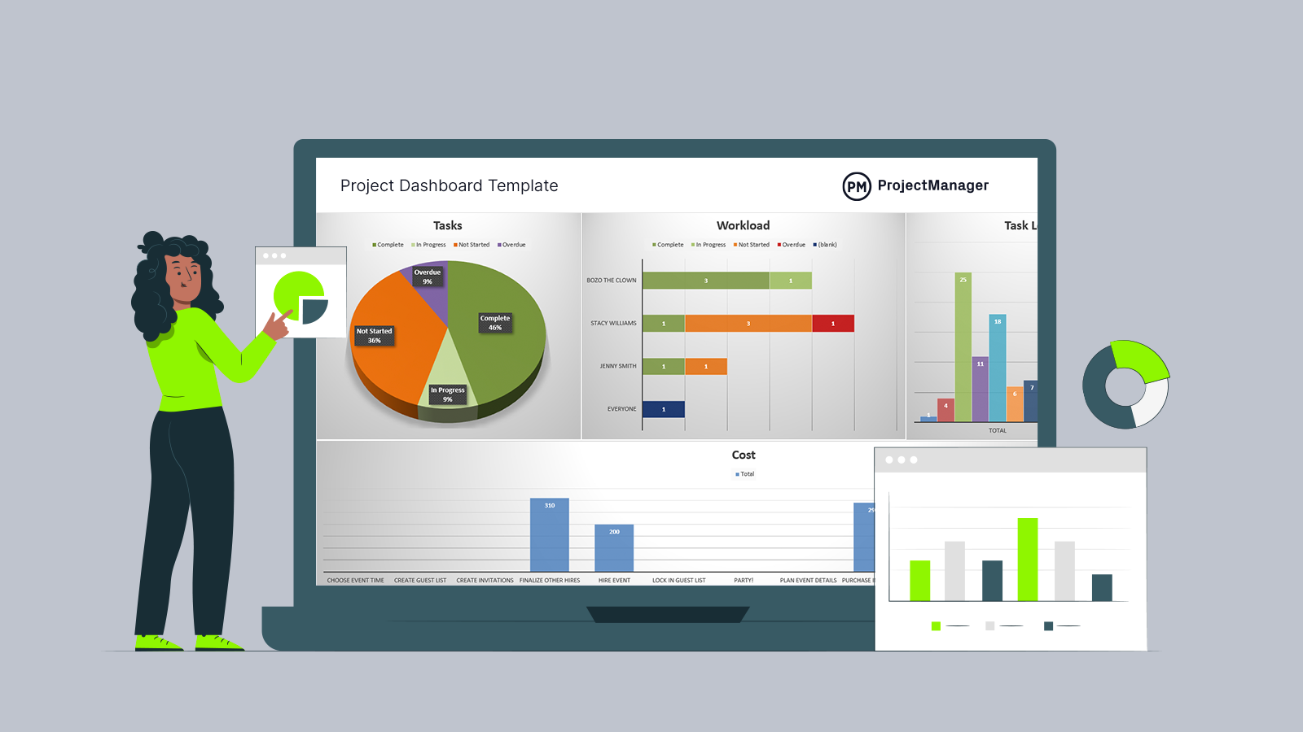


LET’S WATCH OUR DASHBOARD AND LEARN MORE……
https://lookerstudio.google.com/u/0/reporting/68a8975d-c4d7-49a7-8189-e2a3be3c13c1/page/RR2wD

Slide 17
THANK YOU
ANY QUESTIONS?

